Slide 1
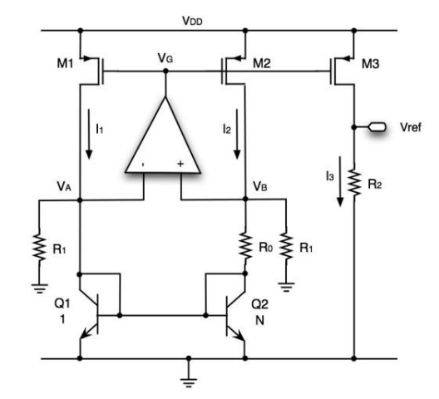
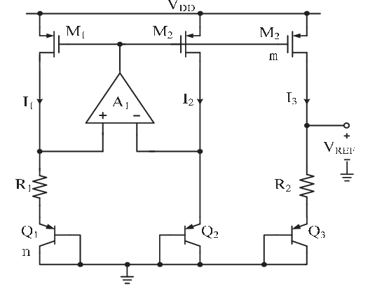


BGR
$$I_{1}=I_{2}=I_{3}=\frac{ln\left(n\right)V_{T}}{R_{1}}$$
$$V_{ref}=V_{BE}+\frac{R_{2}ln\left(n\right)V_{T}}{R_{1}}$$
Pick $R_{1}$ to set current in the branches
Pick $R_{2}$ to cancel the PTAT with CTAT ($\frac{dV_{ref}}{dT}=0$)
$V_{ref}$ set and no control over it, usually around 1.2V
$$I_{1}=I_{2}=I_{3}=\frac{ln\left(n\right)V_{T}}{R_{0}}+\frac{V_{A}}{R_{1}}$$
$$V_{ref}=R_{2}(\frac{ln\left(n\right)V_{T}}{R_{0}}+\frac{V_{A}}{R_{1}})$$
Pick $R_{o}$ or $R_{1}$ to get desired current range
Pick precise $R_{1}$or $R_{0}$ to cancel the PTAT with CTAT
Pick $R_{2}$ to get desired $V_{ref}$
We wanted a $V_{ref}$ of 713mV

Slide 2
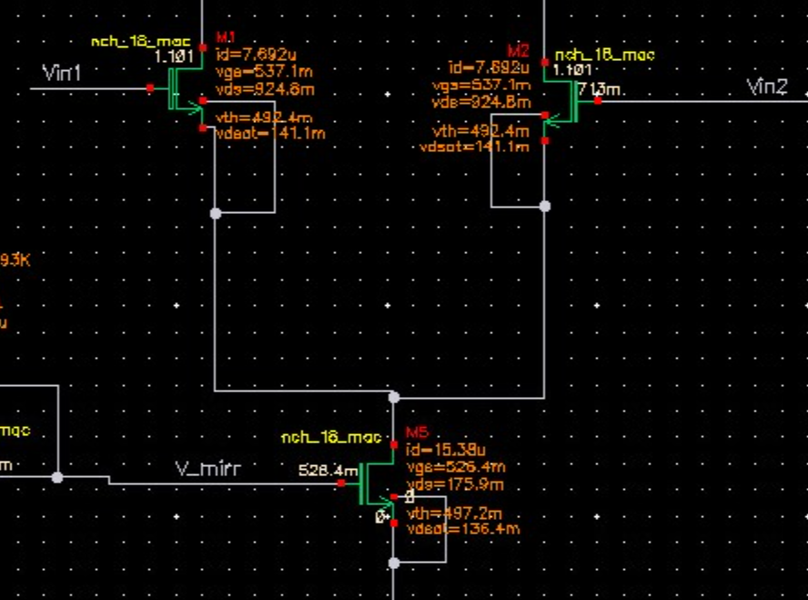
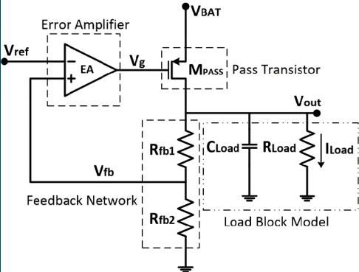

BGR
Why $V_{ref}=0.713V$?
The minimal input common mode voltage of the OTA that will be
used for both BGR and LDO is lower bounded by:
$$V_{in,min}>V_{DSAT_{5}}+V_{GS1}>120+500=620mV$$
Hence, $V_{ref}>0.62V$
2) In the LDO, nominal $V_{out}$ is 0.9V, hence $V_{fb}<0.9V$ thus $V_{ref}<0.9V$
3) $V_{A}=V_{B}=0.713V$, hence $V_{DS}$ will be equal for all current mirror transistors, so current matching is much better, which will improve the PSRR ($V_{ref}$ sensitivity to $V_{DD}$ fluctuations).

Slide 3
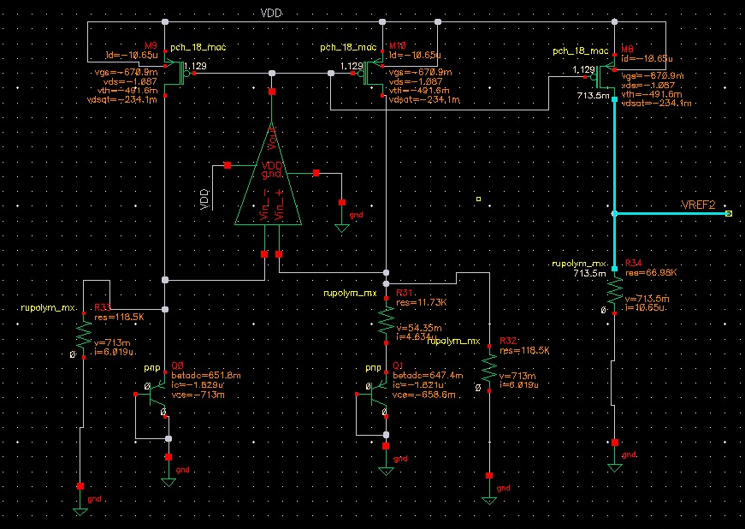
BGR - DC Operating Point

Slide 4
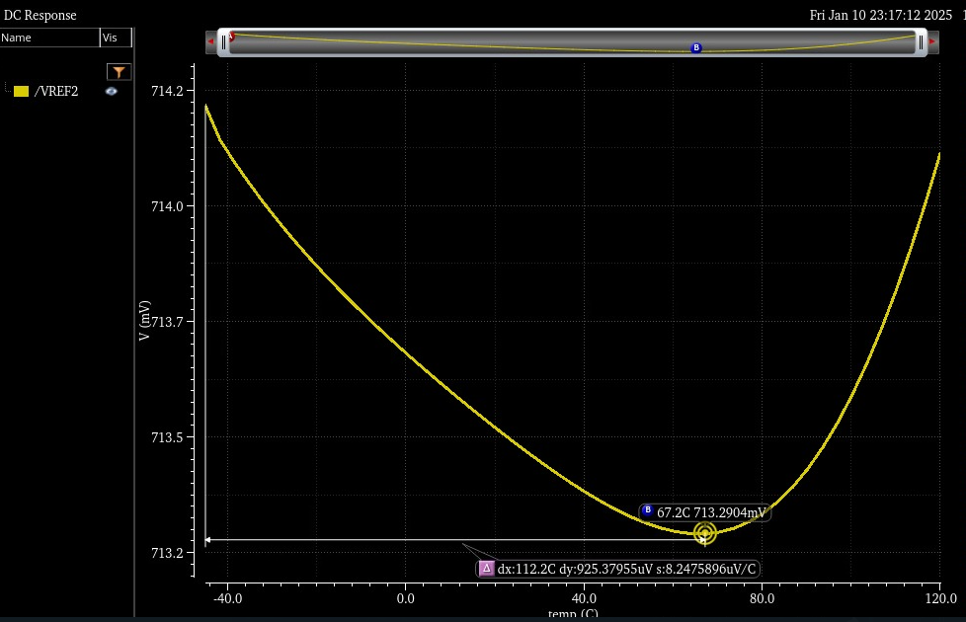

$V_{ref}$ across temperature
Max fluctuation is 0.925mV, approx. $\frac{V_{ref_{max}}−V_{ref_{min}}}{V_{ref_{avg}}∗ΔT}∗10^{6}=7.6\frac{ppm}{°C}$
Increasing the OTA gain can improve the result, currently 69dB

Slide 5
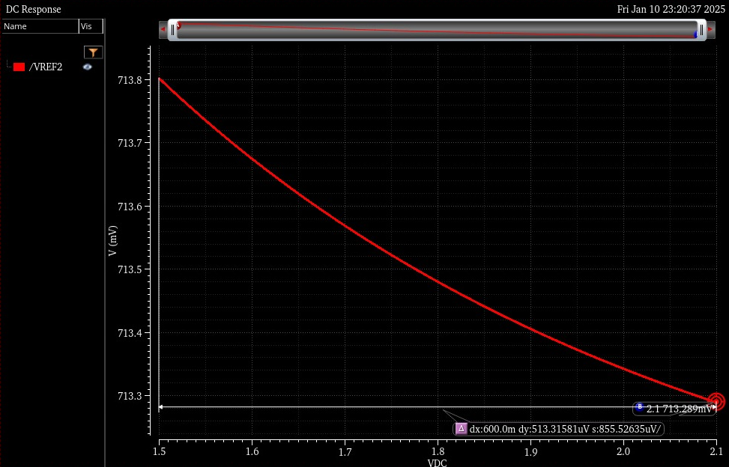

$V_{ref}$ across VDD variation
Max variation is 0.513mV, $PSRR=20log10\left(\frac{ΔV_{DD}}{ΔV_{ref}}\right)=61.3dB$
As expected, better current matching gave us better PSRR

Slide 6
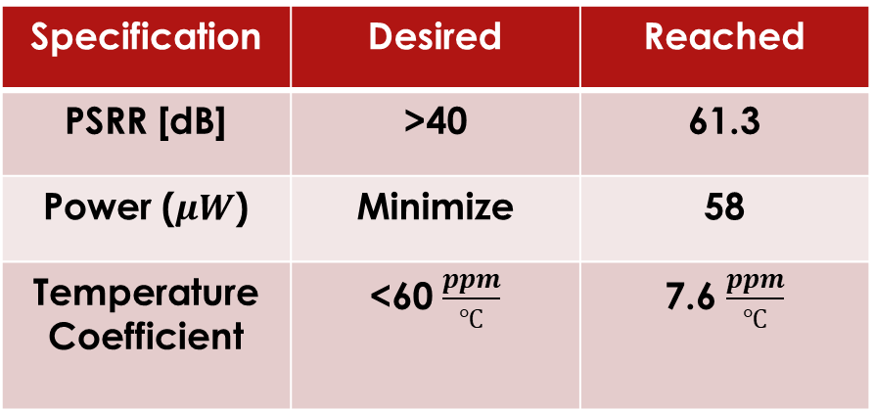
BGR
Specification | Desired | Reached
PSRR [dB] | >40 | 61.3
Power ($μW$) | Minimize | 58
Temperature Coefficient | <60 $\frac{ppm}{℃}$ | 7.6 $\frac{ppm}{℃}$

Slide 7
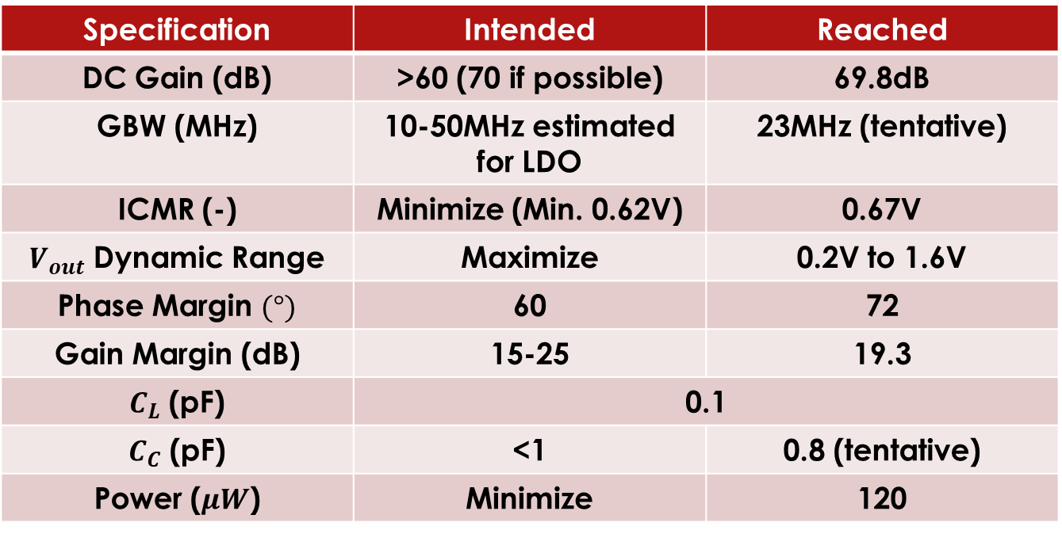
OTA – Design Specs
Specification | Intended | Reached
DC Gain (dB) | >60 (70 if possible) | 69.8dB
GBW (MHz) | 10-50MHz estimated for LDO | 23MHz (tentative)
ICMR (-) | Minimize (Min. 0.62V) | 0.67V
$V_{out}$ Dynamic Range | Maximize | 0.2V to 1.6V
Phase Margin $(°)$ | 60 | 72
Gain Margin (dB) | 15-25 | 19.3
$C_{L}$ (pF) | 0.1
$C_{C}$ (pF) | <1 | 0.8 (tentative)
Power ($μW$) | Minimize | 120

Slide 8
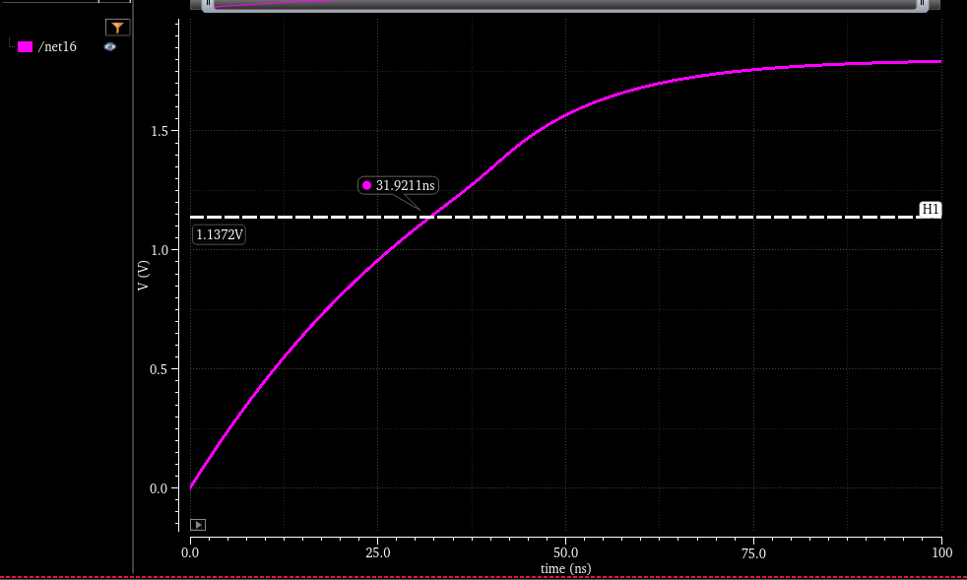

Why $C_{L}=0.1pF$
A 0-1.8V pulse voltage source in series with a 500k resistor at the gate of a PMOS with W=60$μ$, L=150n (LDO pass transistor size)
$$At t=τ=RC: V=0.632V_{max} →C=\frac{τ}{R}=64fF$$

Slide 9
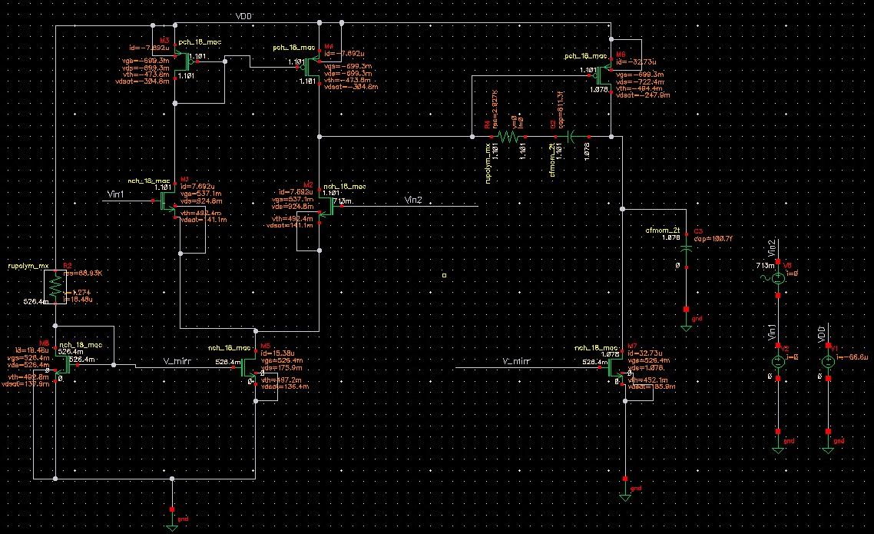
$$DC Operation Point for V_{CM}=0.713V$$

Slide 10
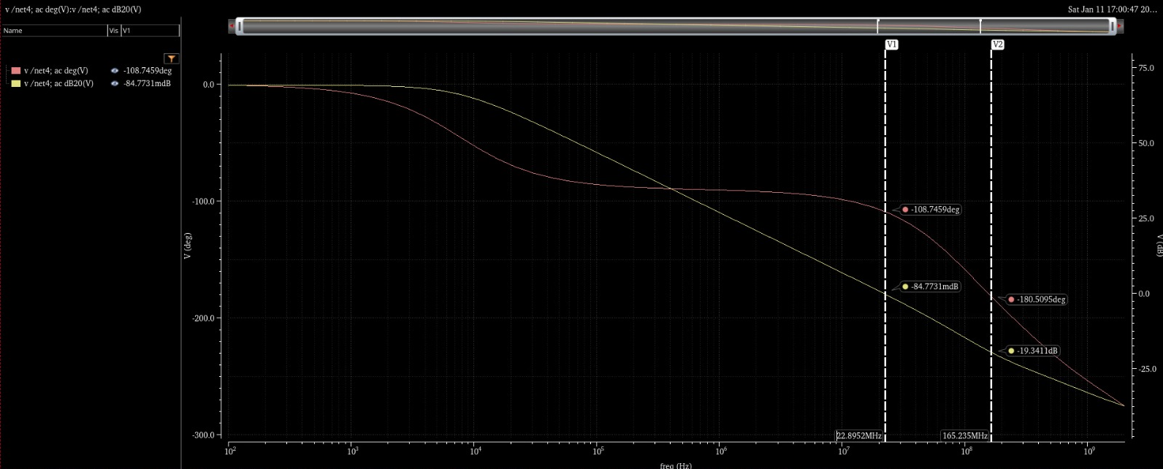
$$AC Response For V_{CM}=0.713V$$
PM of 72 degrees
GM of 19.3dB

Slide 11
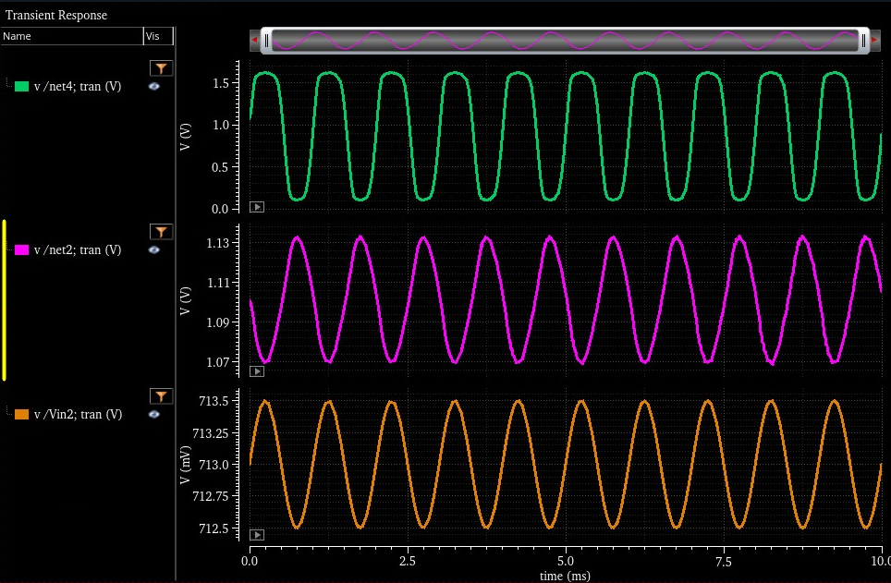
$$Transient Response For V_{CM}=0.713V$$
AC input is a 500uV amplitude sin wave at a 1kHz to the non-inverting input

Slide 12
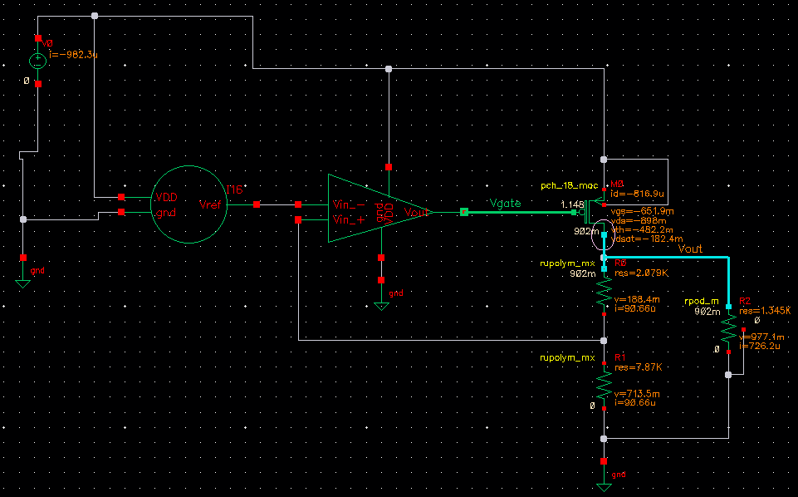
LDO
Initial design of LDO to check the suitability of the BGR and the OTA for the LDO

Slide 13
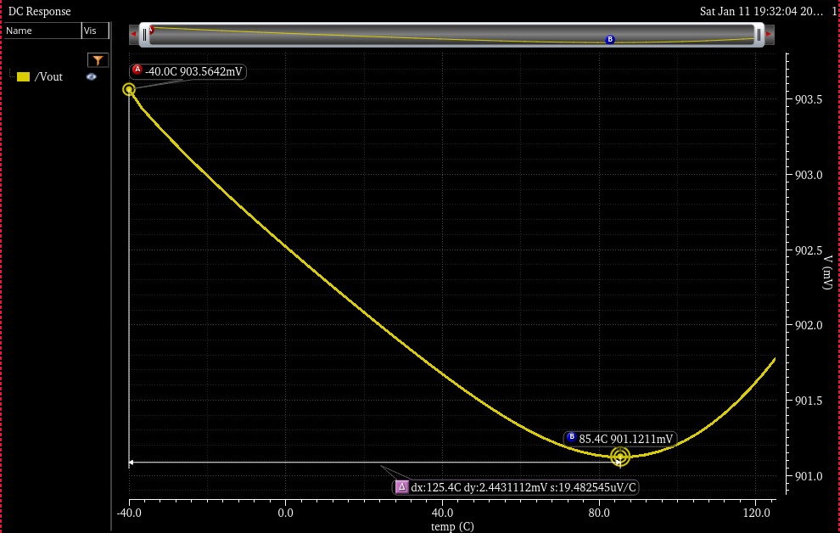

LDO - $V_{out}$ across temperatures

Slide 14
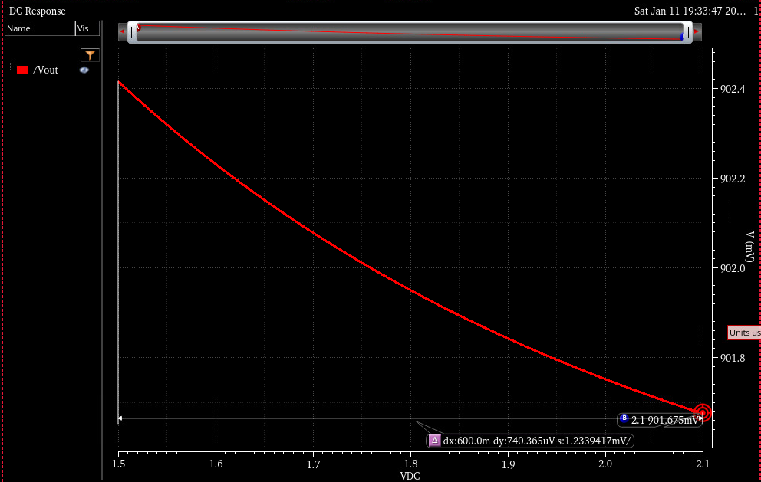
LDO – Line Regulation
How stable $V_{out}$ is despite changes in VDD:
$\frac{ΔV_{out}}{ΔV_{DD}}=\frac{0.74}{600}=0.00123\frac{V}{V}$

Slide 15
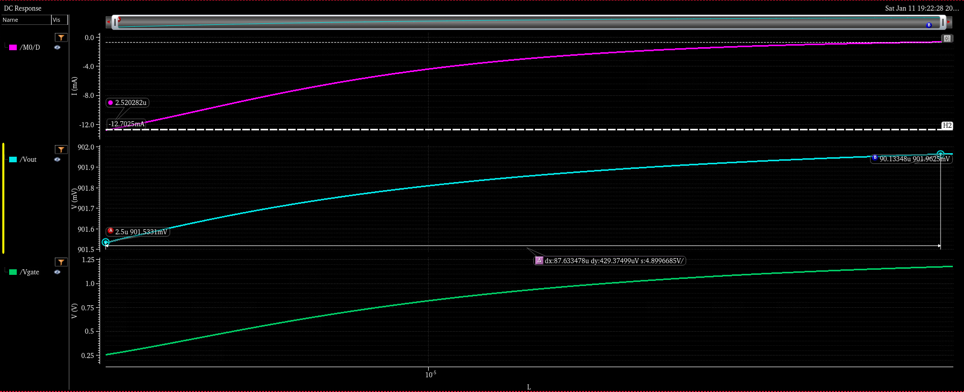

LDO – Load Regulation
How stable $V_{out}$ is despite changes in the load current
$$\frac{ΔV_{out}}{ΔI_{load}}=\frac{0.429mV}{11.9mA}=0.036\frac{mV}{mA}$$
The load resistance changed between 70 to 1200 Ohm

Slide 16
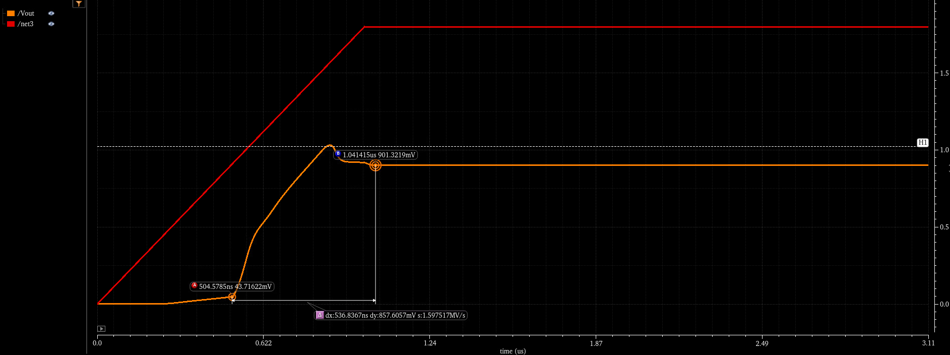

Slide 17
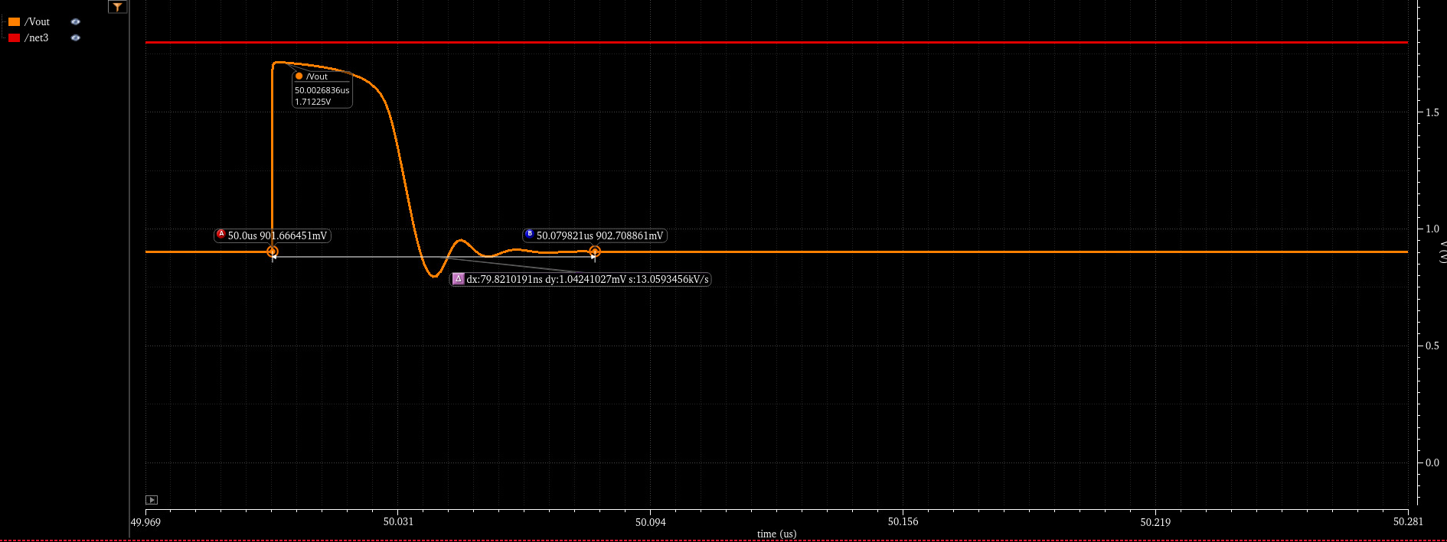
100 to 1000 ohm

Slide 18
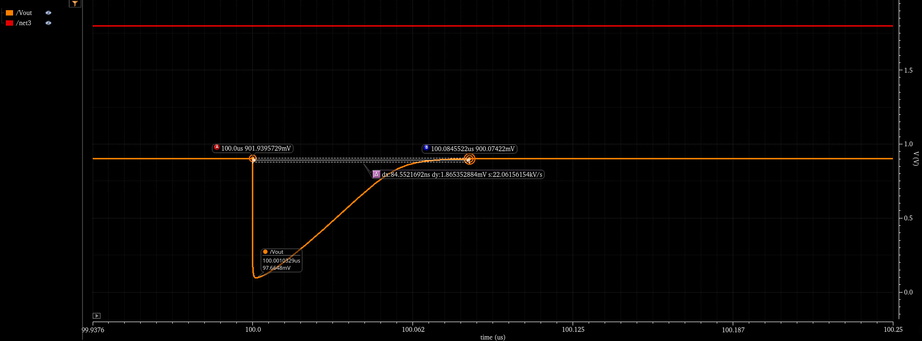
1000 to 100 ohm

